Slide 1
E-Health: Diabetes Analytics Recommendation Engine
(DARE)
Supervisor: Dr. Mohamed Ibnkahla
Co-supervisor: Dr. Zied Bouida
Members:
Lama Yassin Kassab, Biomedical and Electrical Engineering
Leen Yassin Kassab, Biomedical and Electrical Engineering
Pooria Shafia, Biomedical and Electrical Engineering
Mohamed Hozayen, Computer Systems Engineering
Joe Samuel, Software Engineering

Slide 2
Presentation Overview
§Introduction :
§Overview and Background
§Objectives and Specifications
§Performance:
§System Architecture
§Data Generation
§Prediction Engine
§Recommendation Engine
§Conclusion
§Contributions and Innovations
§Future Work

Slide 3
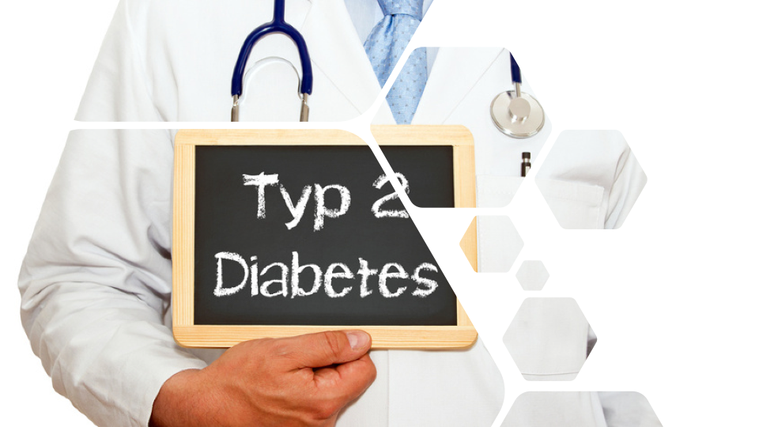

Slide 4
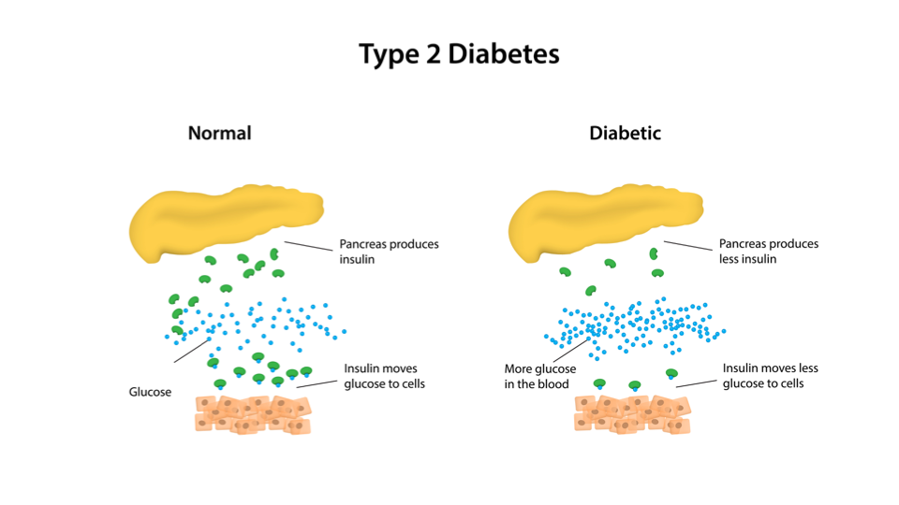

Slide 5
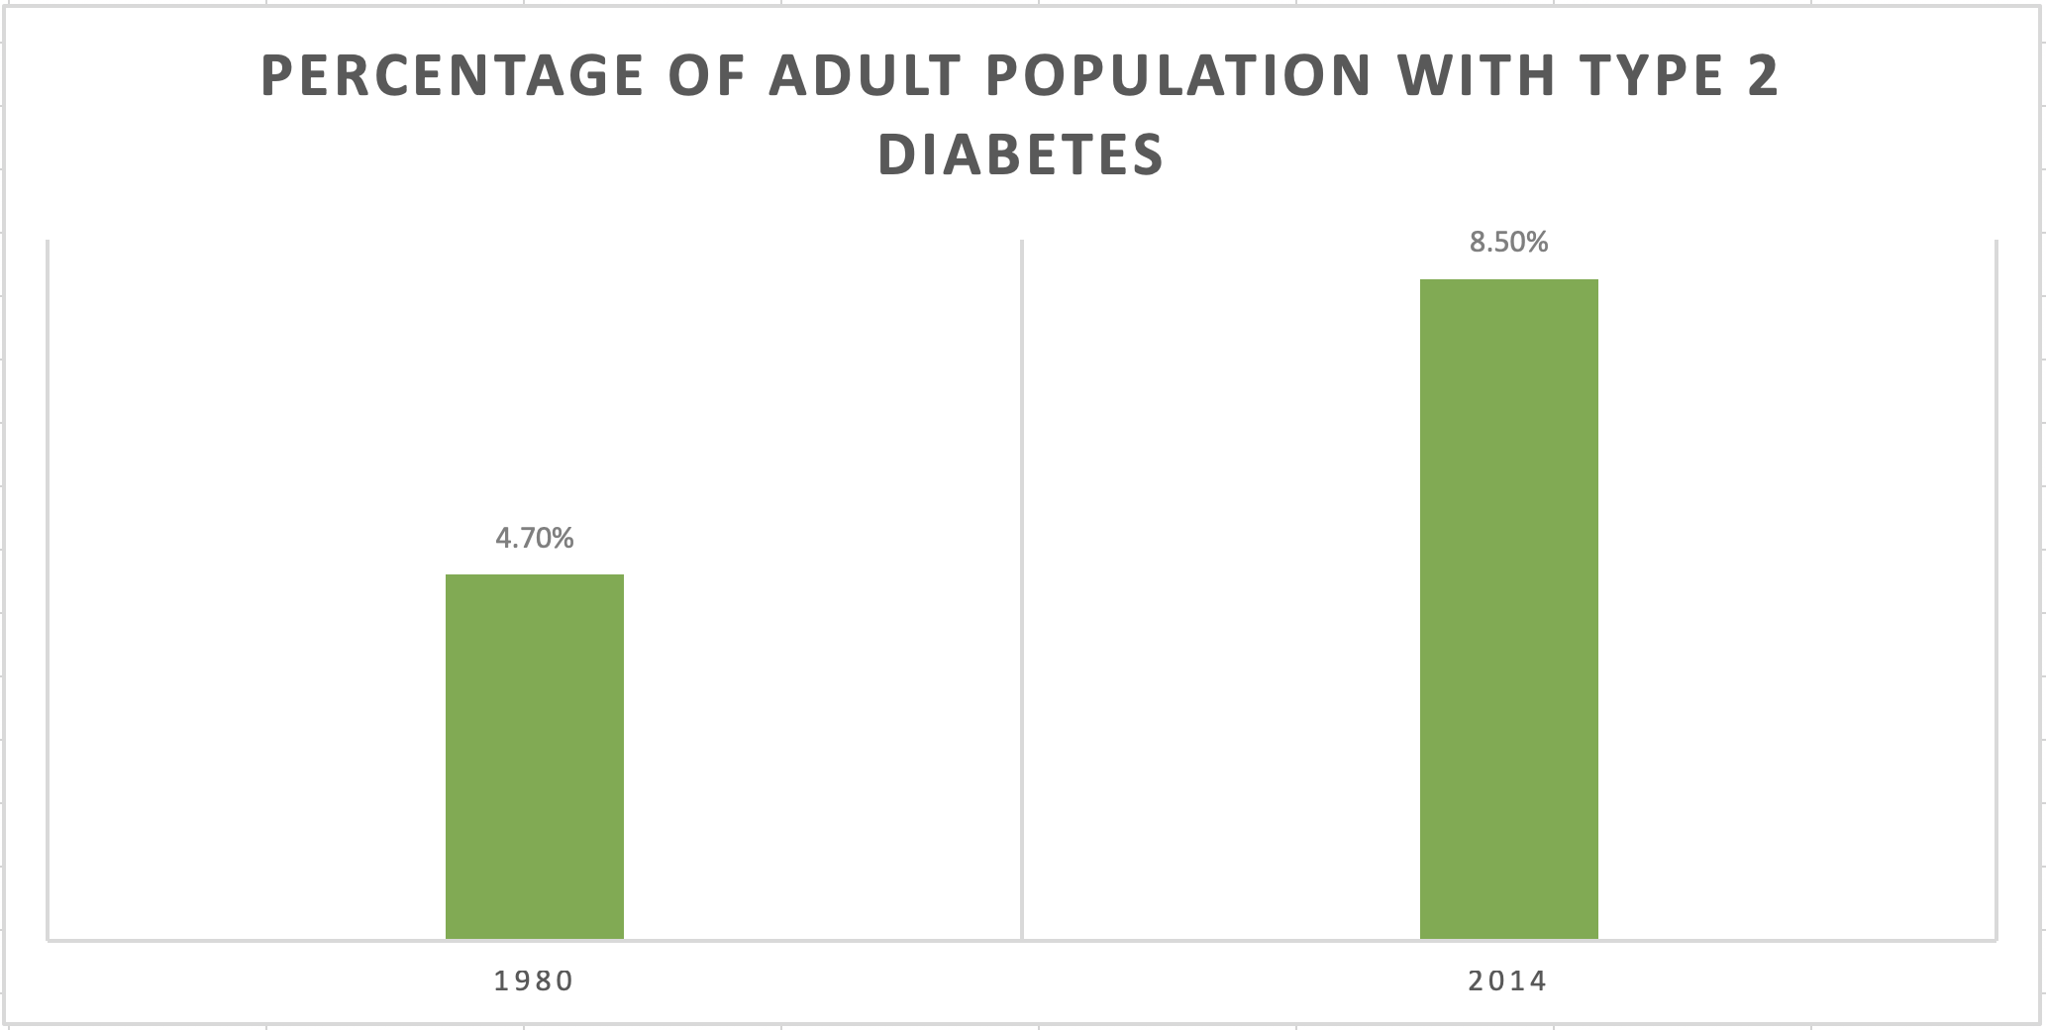

Slide 6
Overview and Background
Why DARE?

Slide 7


Slide 8
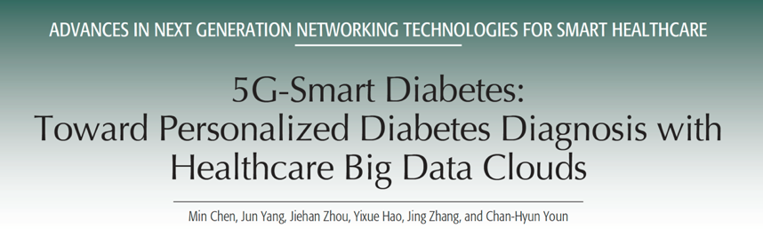

Slide 9
Objectives

Slide 10


OBJECTIVES
Data Analytics
Engine
Correlation between
factors
Recommendation Engine

Slide 11
Performance

Slide 12
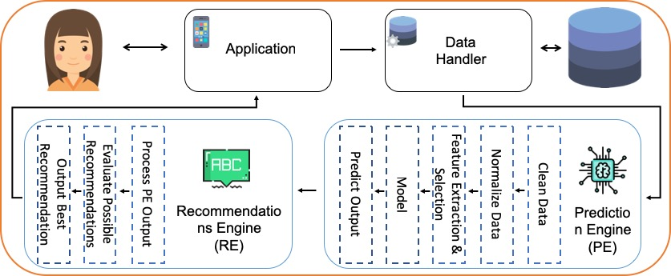
System Architecture
Follows Service-oriented Architecture (SoA)
Self-composed, secure, and modular
Single interfacing point
Scalable

Slide 13
Prediction Engine
Ø Overview of Engine.
Ø In-Depth Analysis of Engine

Slide 14
Overview of Engine.
Prediction Engine
gl(t)
GL(t+τ)

Slide 15
Prediction Engine
Introduction
Goals and Requirements
Long term prediction
Short term predictions
Computation complexity
Real-time processing

Slide 16
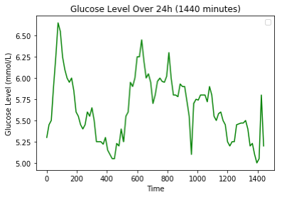
Prediction Engine
Introduction
Goals and Requirements
Long term prediction
Short term predictions
Computation complexity
Real-time processing
Status of data

Slide 17
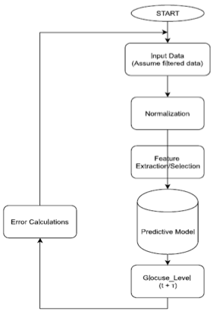
Prediction Engine
Prediction Framework Architecture
Filtered Data
Normalization
Feature Selection
Predictive Model
Output
Error Calculations

Slide 18
Prediction Engine
Prediction Framework Architecture
Filtered Data
Normalization
Feature Selection
Predictive Model
Output
Error Calculations

Slide 19
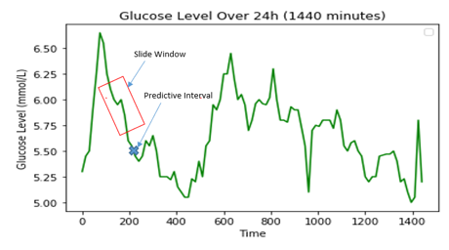
Prediction Engine
Prototype Model
Simple Linear Regression
Slide Window
Window Size
Predictive Interval

Slide 20
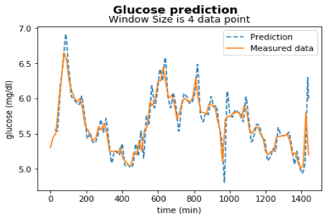
Prediction Engine
Prototype Model
Simple Linear Regression
Slide Window
Window Size
Predictive Interval

Slide 21
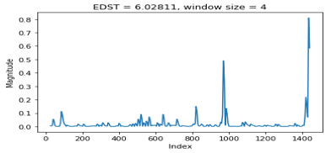
Prediction Engine
Prototype Model
Simple Linear Regression
Slide Window
Window Size
Predictive Interval
How good is it?
Traditional Accuracy
Accuracy = (1-MSE) = 98.9%
Error Measurement Mechanisms
Error Difference Square (EDS)

Slide 22
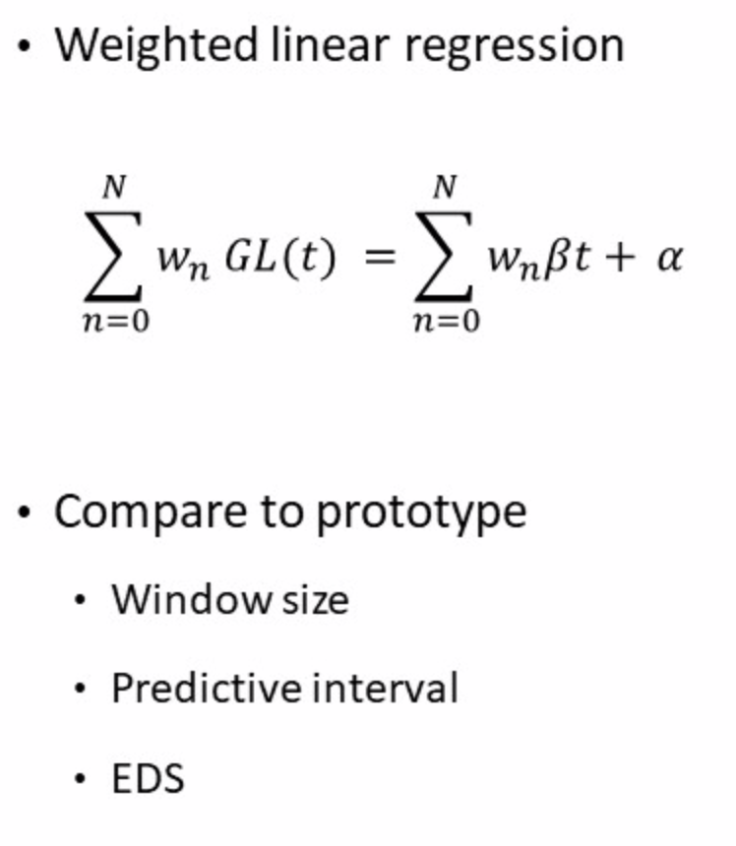
Prediction Engine
Improving the Model

Slide 23
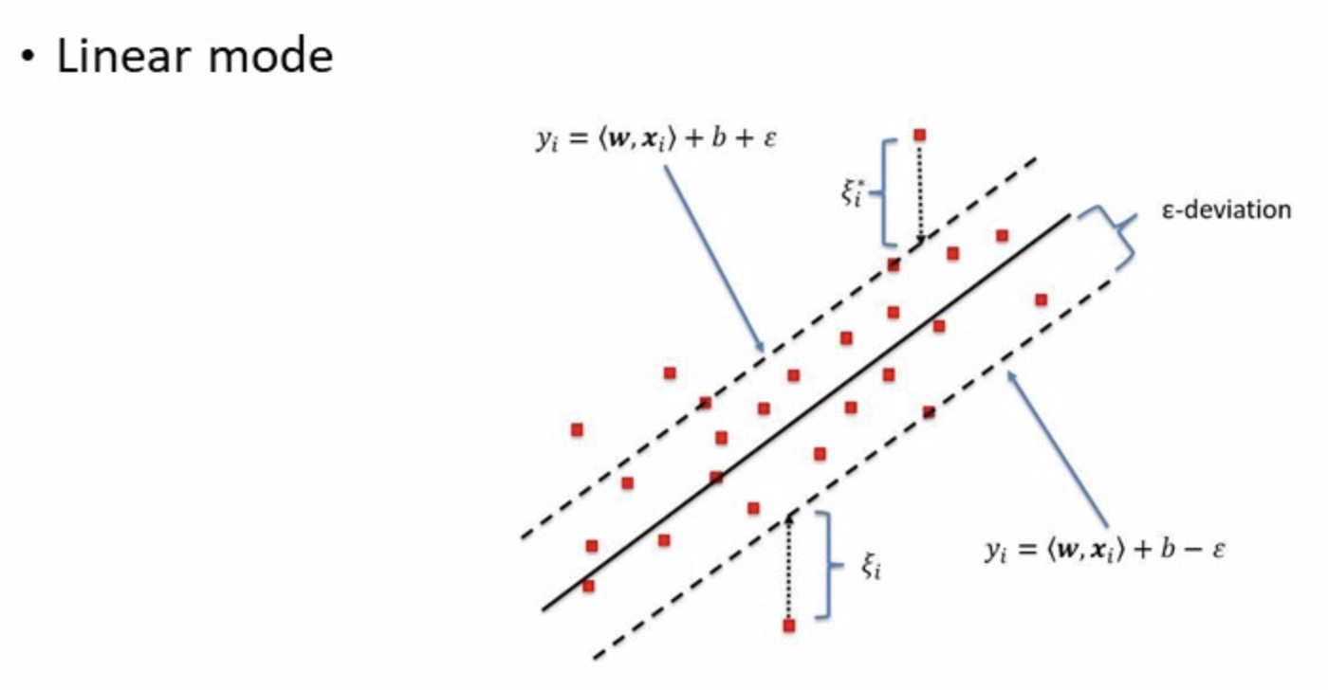
Prediction Engine
Support Vector Regression Model

Slide 24
Prediction Engine
Support Vector Regression Model

Slide 25
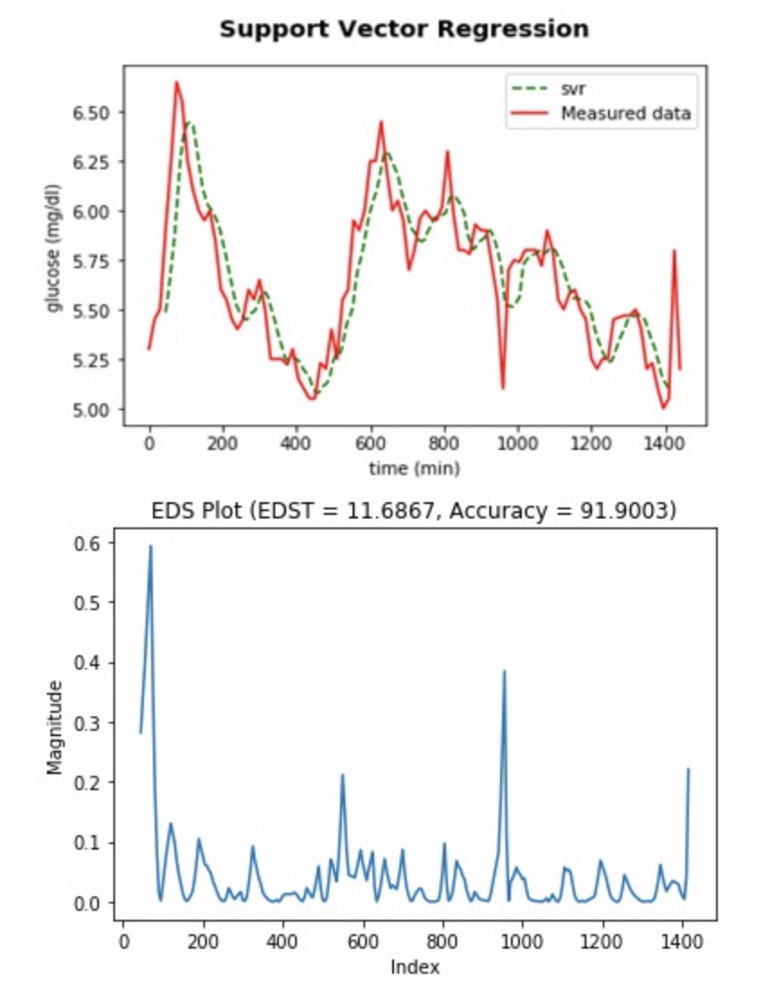
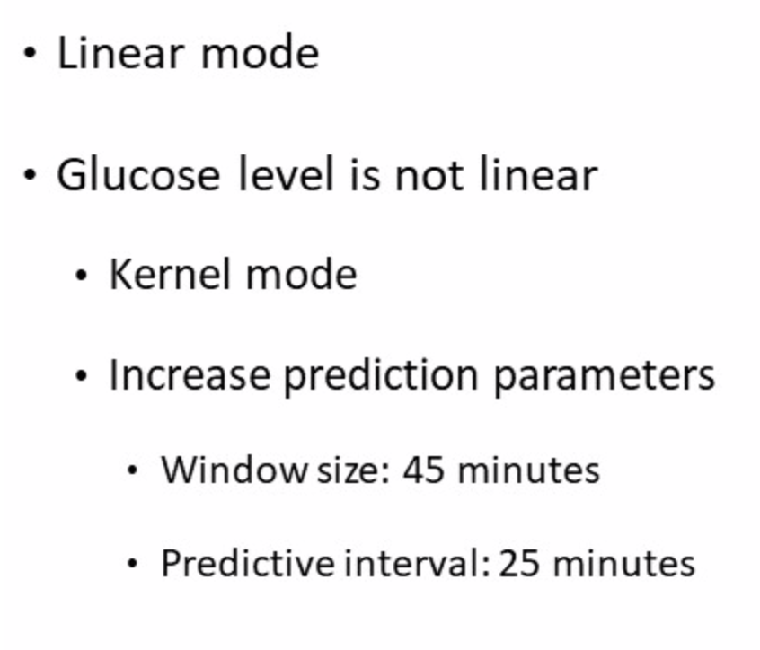
Prediction Engine
Support Vector Regression Model

Slide 26
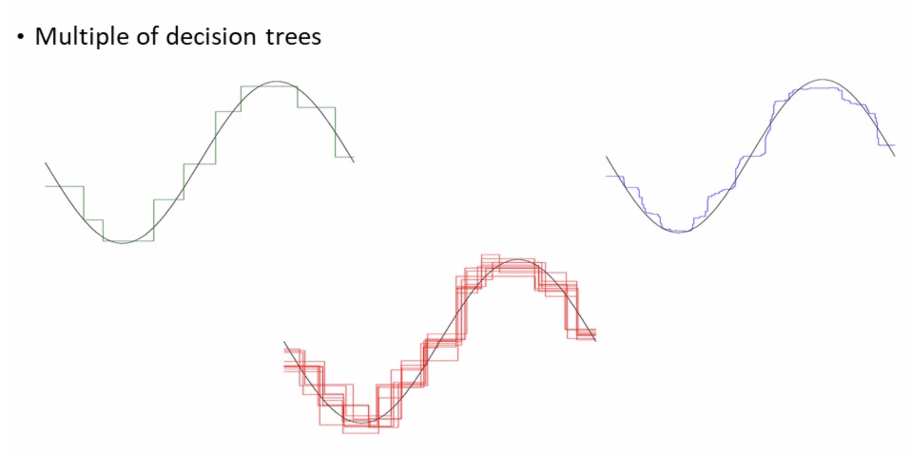
Prediction Engine
Random Forest Regression

Slide 27
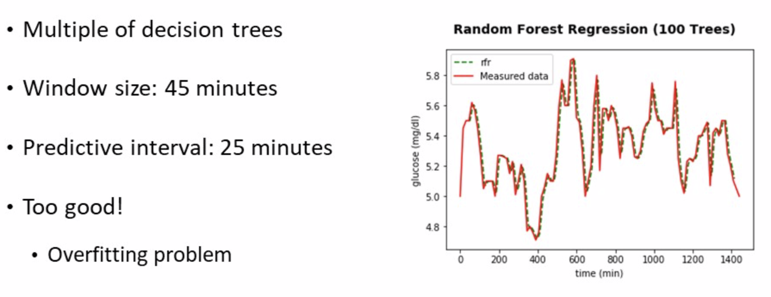
Prediction Engine
Random Forest Regression

Slide 28
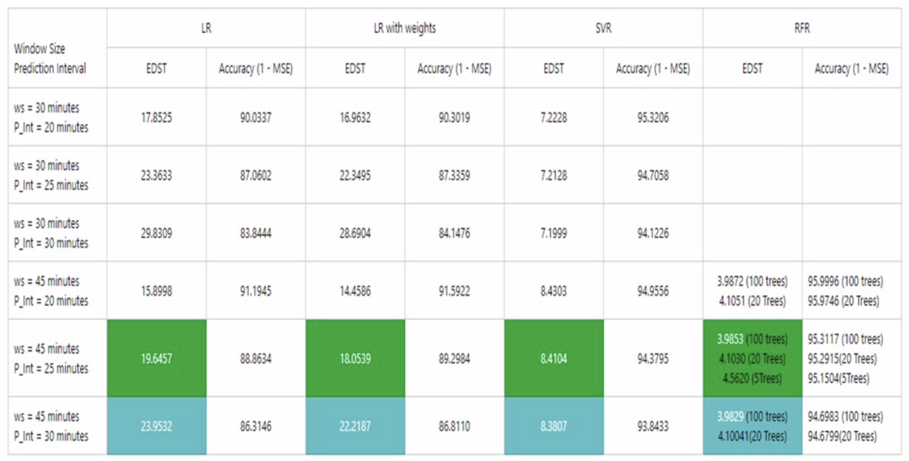
Prediction Engine
Comparing Models

Slide 29
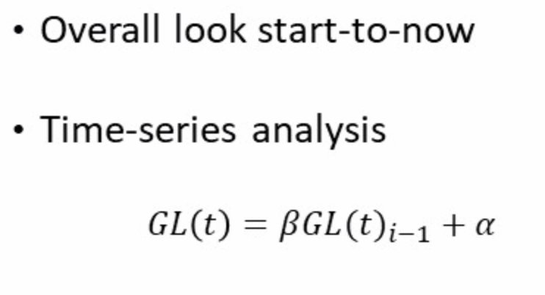
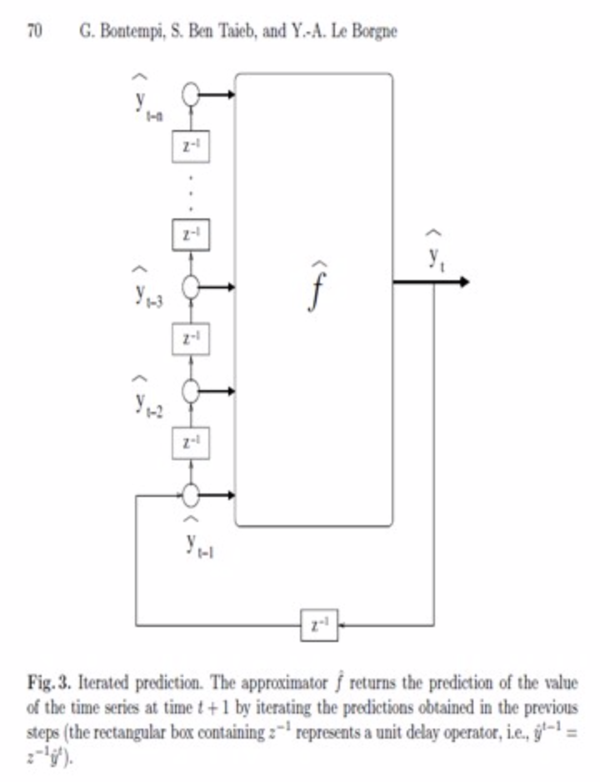
Prediction Engine
Conclusion

Slide 30
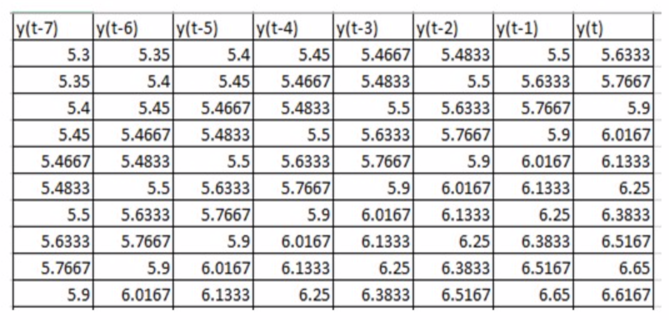
Prediction Engine
Conclusion

Slide 31
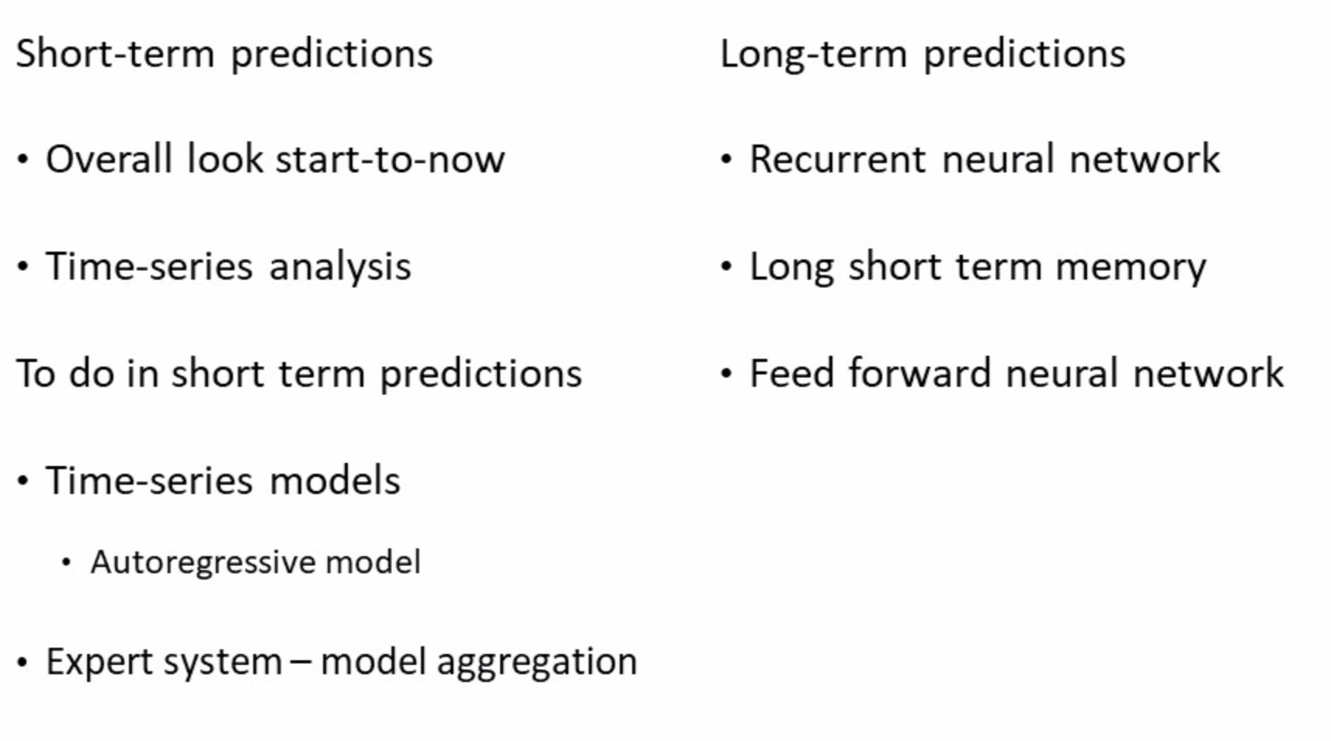
Prediction Engine
Conclusion

Slide 32
Recommendation Engine

Slide 33
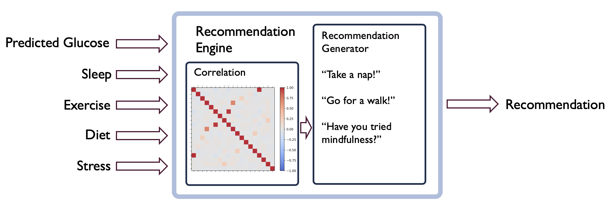
Recommendation Engine
Highly individualized - Correlations unique to individual
Smart - Best recommendation only
Modular - Customizing algorithm and recommendations

Slide 34
Application Interface

Slide 35
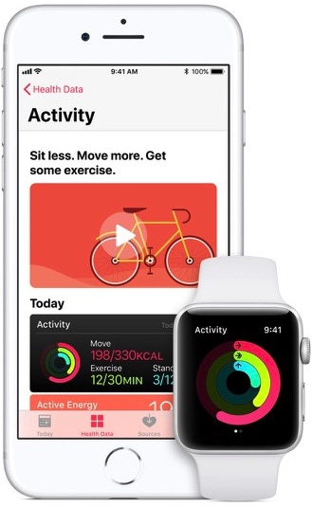
Application Interface
Cross-platform, web-based
Harnesses platform API’s
Intuitive data collection
User-centric

Slide 36
Data Generation

Slide 37

Associations Contacted
Health Canada
CHEO
The Heart Institute
Macadamian
5-G Smart Diabetes Authors

Slide 38
Solution
From the available literature, 12 profiles of glucose data were obtained over a 24 hour period
6 healthy profiles
6 diabetic profiles
Data step size was 15 minutes
After that, MATLAB was used to generate more data

Slide 39
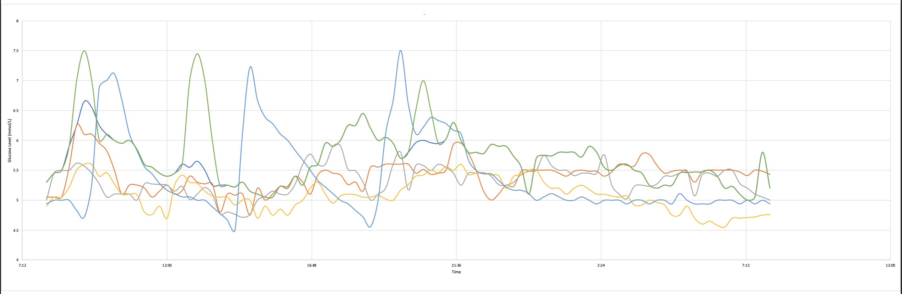
24-Hr Profiles
Healthy

Slide 40
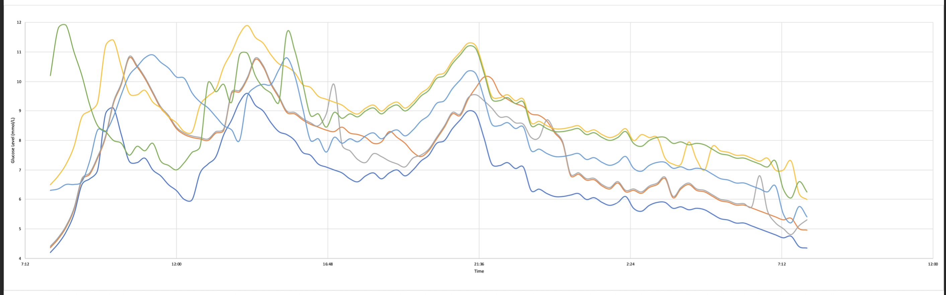
24-Hr Profiles
Diabetic

Slide 41
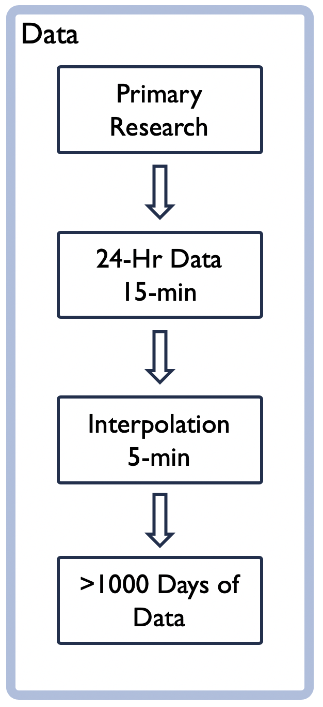
Generating Data
Interpolation
No drastic change in glucose level over 15 mins
15 mins to 5 mins
Increased resolution

Slide 42
Generating Data
MATLAB - 1024 Days of Data
Variation was important
Random normal function
Best with 0.1 sigma
Baseline shift
Stress
Shift left and right
Diet and exercise schedule

Slide 43
Generating Data
Result
12 Cases (6 Healthy, 6 Diabetic)
~3500 points to 1.8M points
Notes
Data aimed at preliminary training
More accurate/real data required
Code is a framework!

Slide 44
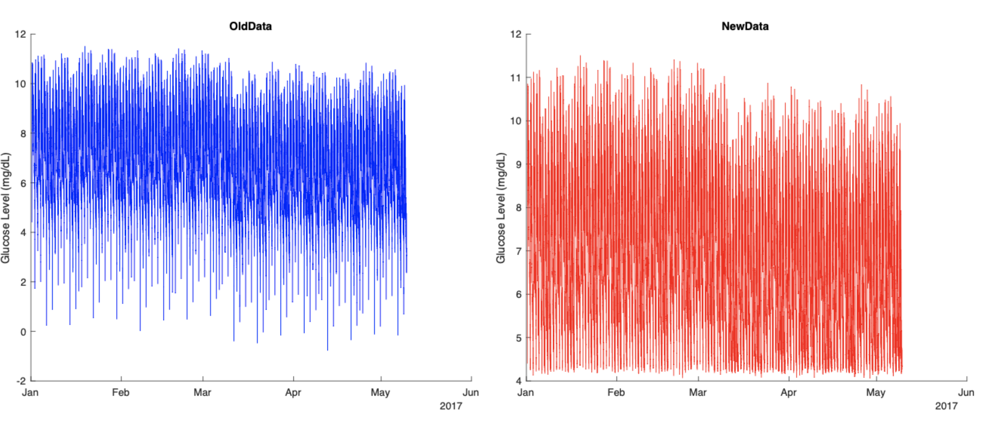
Data Clean Up

Slide 45
Next Steps

Slide 46
Tuning up of neural network for refined prediction
Testability (conducting a variety of integration tests to ensure system integrity)

Slide 47
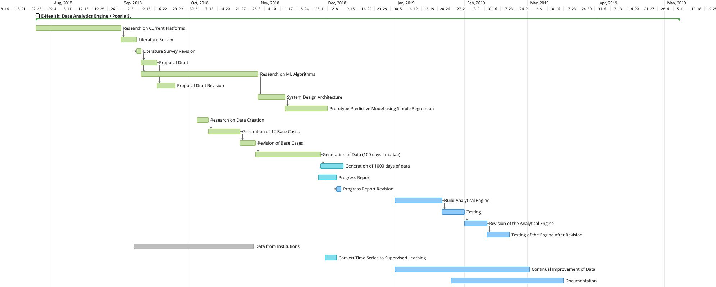
GANTT Chart

Slide 48
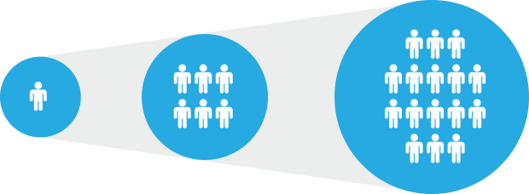
Step into the future
Neural network based prediction
Independently deployable
Big-data ready

Slide 49
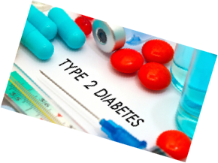
Conclusion
üMeeting deadlines
References
M. Chen, J. Yang, J. Zhou, Y. Hao, J. Zhang, and C. H. Youn, “5G-Smart Diabetes: Toward Personalized Diabetes Diagnosis with Healthcare Big Data Clouds,” IEEE Commun. Mag., vol. 56, no. 4, pp. 16–23, 2018.
World Health Organization, “Global Report on Diabetes,” Isbn, vol. 978, p. 88, 2016.
S. L. Norris, M. M. Engelgau, and K. M. Narayan, “Effectiveness of self-management training in type 2 diabetes: a systematic review of randomized controlled trials.,” Diabetes Care, vol. 24, no. 3, pp. 561–587, 2001.
D. Of and D. Mellitus, “Diagnosis and classification of diabetes mellitus,” Diabetes Care, vol. 37, no. SUPPL.1, pp. 81–90, 2014.
Kleynhans T, Montanaro M, Gerace A, Kanan C. “Predicting Top-of-Atmosphere Thermal Radiance Using MERRA-2 Atmospheric Data with Deep Learning”, November 2017
SVR: http://qetartu.blogspot.com/2016/12/applied-econometrics-statistical.html
Bontempi G, Ben Taieb S, Le Borgne Y. ”Machine Learning Strategies for Time Series Forecasting.”
Thank to www.flaticon.com for providing some of the visual elements.

